Slide 1
Front End Engineering-I Project
Team Details:
Bhupesh Relan - 2210991447
Bhuvan Kumar - 2210991448
Bhuvesh Kumar -2210991449
Bhuvesh Mittal -2210991450
Faculty Coordinator : Dr. Ajay kumar
:
Chitkara University Institute of Engineering and Technology,
Chitkara University, Punjab

Slide 2
Table of Contents
Introduction
Problem Statement
Technical Details
Project Advantages & Key Features
Project Highlights
Conclusion
Future scope
References/Links used

Slide 3

Introduction
Social share buttons are a set of clickable icons or buttons placed on web pages, blog posts, or other digital content that allow users to easily share that content on social media platforms

Slide 4
Problem Statement
In this project, we will take up the challenge of writing JavaScript code that will allow us to add social share buttons to static sites. While we can do this by incorporating HTML elements or images in the site’s template, using JavaScript allows us to add the share buttons dynamically.

Slide 5
Technical Details
USE OF HTML
HTML can be used to create the content of a social share buttons, as well as provide the structure and layout of the web pages. Here are some key points why we use HTML in social share buttons:
1.Content: HTML can be used to create the content of the buttons, such as text, images, or links.
2.Structure: HTML can be used to define the structure and layout of the pages, such as its size, position, and background colour.
3.Customization: HTML can be customized with CSS to match the look and feel of the application, including the font, colour, and layout of the button & pages.
4.Responsiveness: HTML can be used to create responsive buttons that adapt different screen sizes and devices, ensuring that the button is legible and visually appealing on all devices.
5.Accessibility: HTML can be used to ensure that the website is accessible to all users, including with disabilities. For e.g., HTML can be used to provide alternative text for images or to use semantic HTML to make the button more understandable for screen readers.

Slide 6
USE OF CSS
CSS can be used to style the appearance and behavior of social share buttons in web applications. Here are some ways CSS can be used in:
Positioning: CSS can be used to position share buttons on the screen, such as at the top or bottom of the screen. This can be achieved using the CSS position property and the top, bottom, left, or right properties.
Styling: CSS can be used to style the appearance of web pages, such as the background colour, font, and size of the text, and the border and box-shadow properties of the notification container.
Animation: CSS animations can be used to add visual effects to buttons, such as fading in and out or sliding up and down. This can be achieved using the CSS animation property and the key frames rule.
Responsive design: CSS can be used to make buttons responsive, so they adapt to different screen sizes and devices. This can be achieved using media queries to define different styles for different screen sizes.
Customization: CSS can be used to customize buttons to match the look and feel of the application, using the application's colour scheme and branding.

Slide 7
Use of JavaScript
JavaScript plays a crucial role in implementing share buttons and provides several key uses. Here are some common uses of JavaScript in share button functionality:
1.Displaying and Hiding: JavaScript is responsible for showing the share buttons. It can add or remove classes to control the visibility, position, and animation effects of the toast share buttons.
2.Dynamic Content: JavaScript enables dynamic content in web pages. It allows for personalized or real-time information to be shared by the buttons.
3.Interaction and Event Handling: JavaScript allows for interaction with the buttons. For example, we can include links in the buttons, and JavaScript can handle click events on those elements. This enables actions like redirecting to another page, or performing specific operations based on user input.
4.Customization and Styling: JavaScript can be used to apply custom styles and animations to the buttons. By dynamically updating the CSS properties or classes, JavaScript allows for flexible customization to match the overall design of the website or application.

Slide 8
Key Features
Some of the key features of social share buttons include:
Social share buttons are designed to work with popular social media platforms
Social share buttons are typically very easy to use.
Social share buttons can be customized to fit the design and branding of a website or blog
They are designed to be responsive and work well on smaller screens.
Social share buttons help promote social engagement and increase the reach of content.

Slide 9
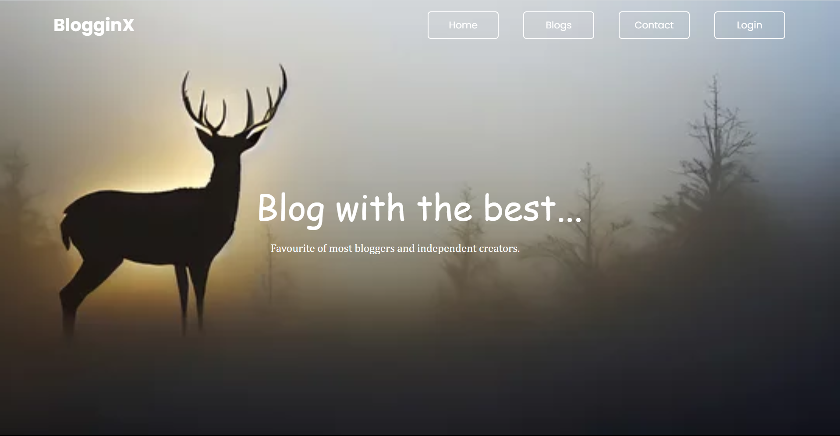
Results

Slide 10
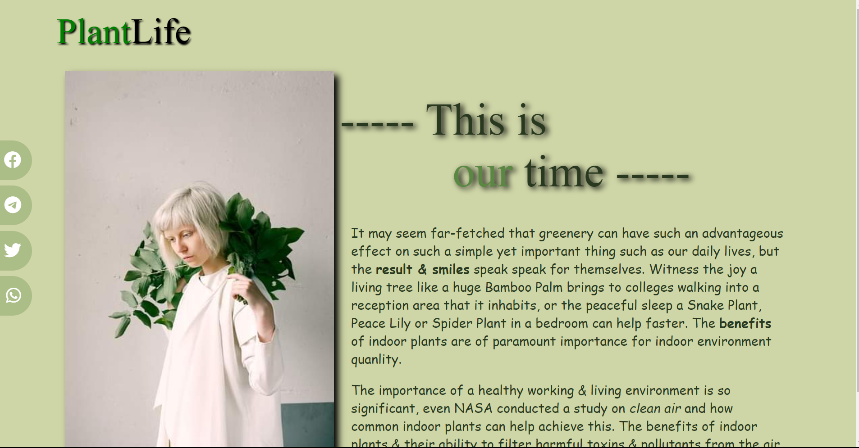

Slide 11
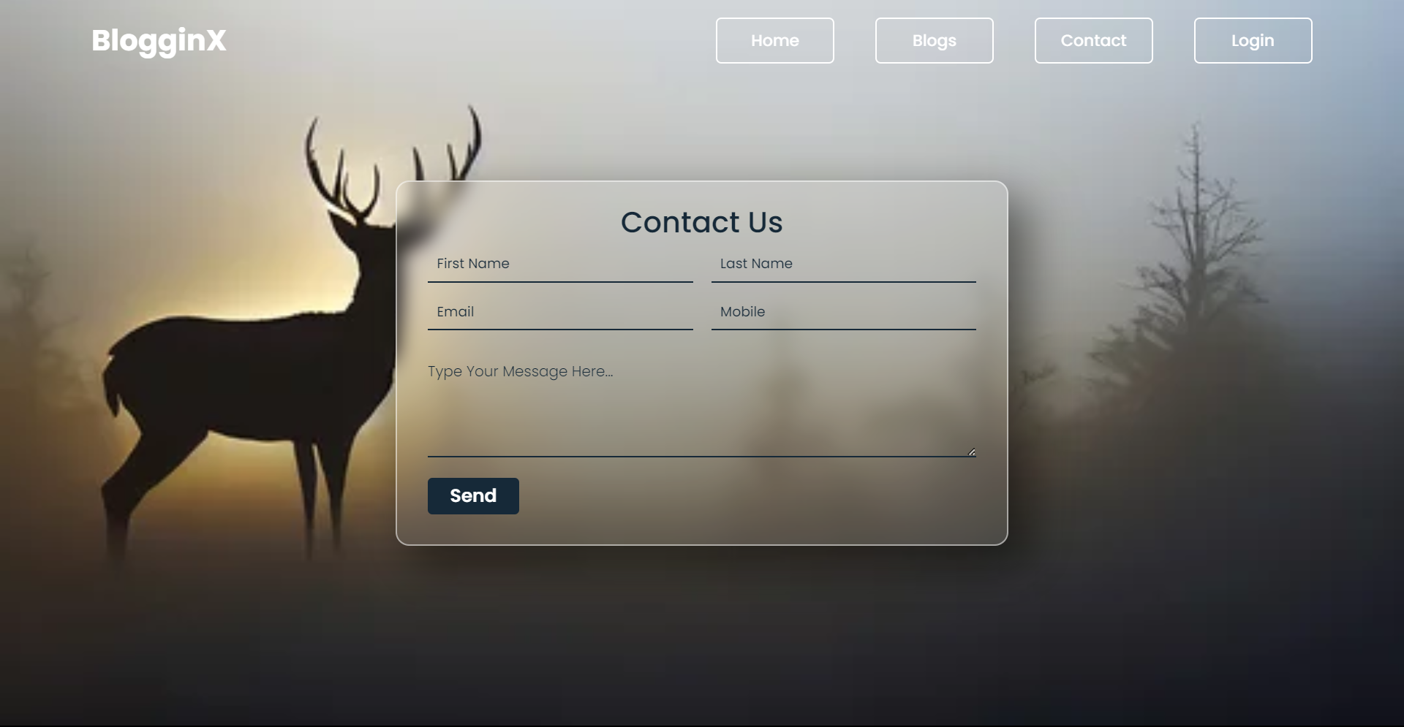

Slide 12
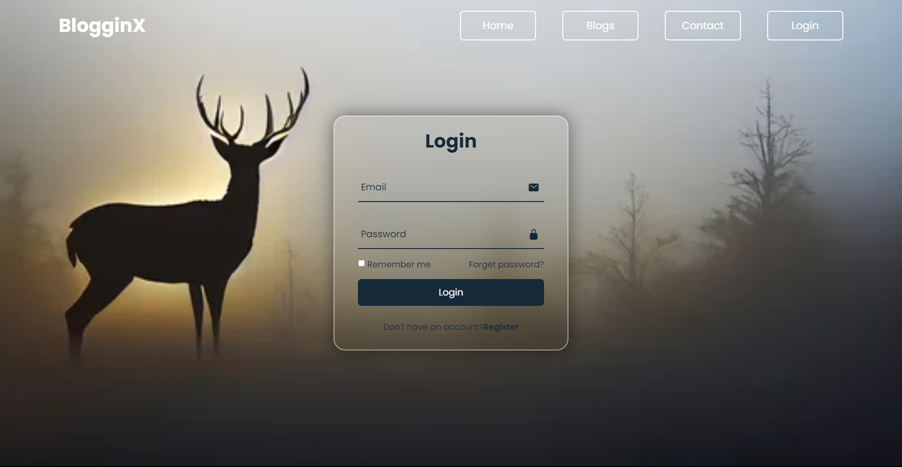

Slide 13
Conclusion
Social share buttons are a valuable tool for website and content creators to increase their social media presence and promote engagement with their audience. These buttons offer a range of features, including integration with social media platforms, ease of use, customization options, trackability, mobile-friendliness, and the ability to promote social engagement. By incorporating social share buttons into their digital content, website and content creators can increase their online visibility and reach a wider audience, ultimately helping them achieve their marketing and communication goals.

Slide 14
Future Scope
The future scope of a project on social share buttons using HTML and CSS is promising, as social media continues to play a significant role in marketing and advertising. Here are some potential future developments for such a project:
1. Integration with new social media platforms: As new social media platforms emerge and gain popularity, there will be a need to integrate them into the social share buttons to keep up with user preferences and behaviors.
2. Personalization and customization: Users may want to customize the social share buttons to match their personal preferences or branding needs, which may require additional features to be added to the project.
3. Optimization for different devices: As technology continues to evolve, there will be a need to optimize the social share buttons for new devices and screen sizes, including wearables, smart TVs, and virtual or augmented reality devices.
4. Advanced tracking and analytics: Advanced tracking and analytics can help to monitor the effectiveness of the social share buttons and provide insights for further optimization.
5. Integration with other tools and technologies: There may be a need to integrate the social share buttons with other tools and technologies such as email marketing, analytics, or content management systems.

Slide 15
References/Links used
https://dribbble.com/shots/6211462-Daily-UI-010-Social-Share/attachments/6211462-Daily-UI-010-Social-Share?mode=media
https://youtu.be/7bVl8zyKr8g
https://youtu.be/p1GmFCGuVjw

Slide 16


